Slide 1

DataQuest
Megalith
Gradient Boosters -
Vishesh Gupta ( Team Leader )
Uttkarsh Solanki
Sahil Ranjan
Aditya Bisht
Sarthak Jain
Notes:
df

Slide 2







M.L.
Model
Introduction
Proposed
Solution
Introduction
EDA
Conclusion
Road accidents are a critical public safety issue, particularly in urban areas with high traffic density.
Accident outcomes vary widely, from minor injuries to fatal crashes, highlighting the need for targeted interventions.
The Challenge:
Accurate predictions of crash severity can:
Enable authorities to implement targeted measures such as better road design, enhanced signage, or stricter speed limits.
By identifying patterns of high-severity crashes, preventive actions can save lives and minimize damage.
Why it matters?:
Leverage historical accident data combined with machine learning to:
Identify key risk factors (e.g., road conditions, driver behavior).
Develop predictive models for crash severity.
Recommend actionable safety measures to mitigate risks.
Oppoutunity:
Build a predictive model to classify accident severity as Minor Injury, Major Injury, or Fatal Crash using provided datasets and modern machine learning techniques. Using the data from the model obtained, provide solutions to reduce the risks involved in crashes.
OBJECTIVE:

Slide 3
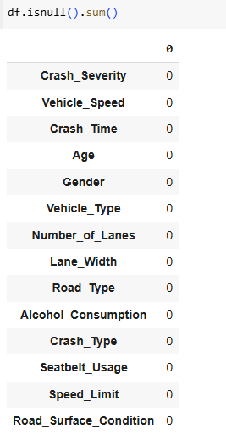
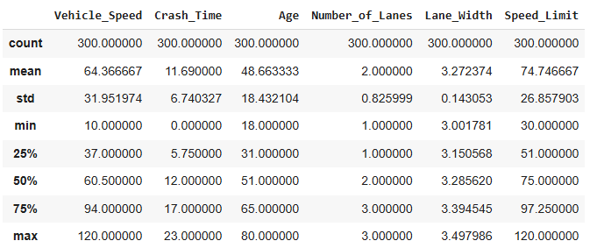
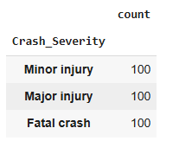
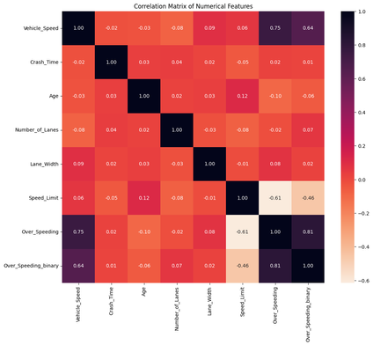
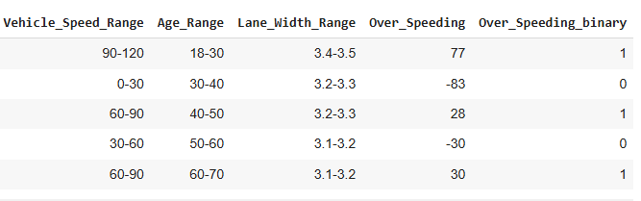
EDA & Feature Engineering
M.L.
Model
Introduction
Proposed
Solution
EDA
Conclusion
Data Insights
The dataset comprises 300 rows and 14 feature columns, including 7 categorical features. It is well-prepared, with no missing values and a perfectly balanced class distribution, ensuring there is no class imbalance. The features exhibit minimal correlation, and the data contains very few outliers. These characteristics indicate that the dataset has already undergone thorough preprocessing, making it clean and ready for analysis.
Correlation matrix
Feature engineering
Vehicle Speed Range: Categorizes speeds into ranges (e.g., "0-30", "30-60")
Benefit: Identifies the correlation between speed ranges and crash severity.
Age Range: Groups ages into intervals (e.g., "18-30", "30-40").
Benefit: Helps analyze crash trends among different age demographics.
Lane Width Range: Divides lane widths into small ranges (e.g., "3-3.1", "3.1-3.2").
Benefit: Assesses the impact of lane width on crash frequency and severity.
Over Speeding: Measures the difference between vehicle speed and speed limit.
Benefit: Flags instances of speeding, critical for studying risky driving behaviors.
Over Speeding Binary: Converts over-speeding into a binary format (1: speeding, 0: no speeding).
Benifit:For checking if a driver is overspeeding or not

Slide 4
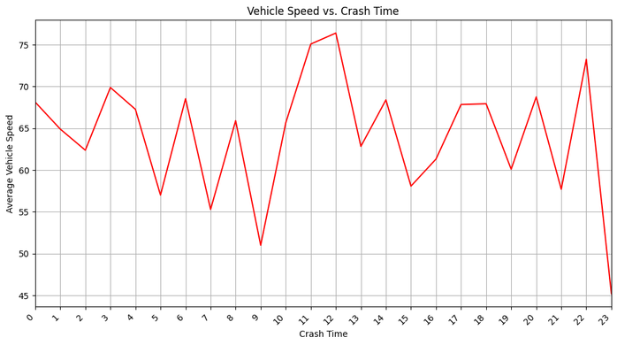
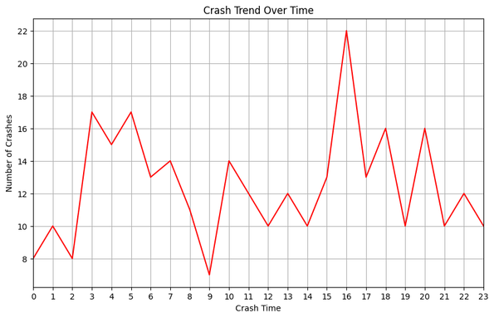
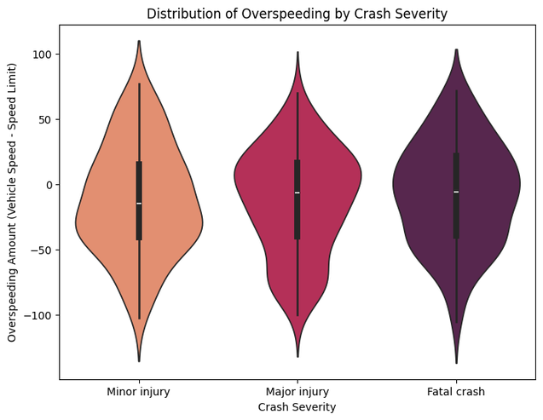
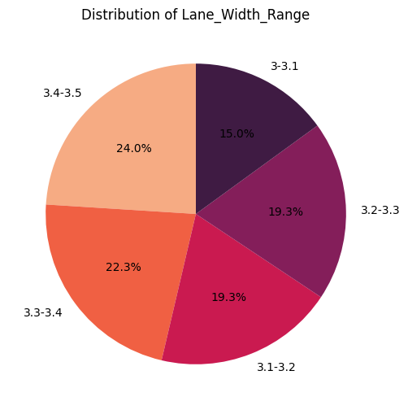
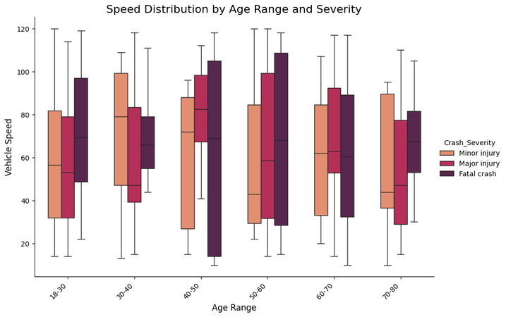
EDA & Feature Engineering
M.L.
Model
Introduction
Proposed
Solution
EDA
Conclusion
IMPORTANT GRAPHS AND INSIGHTS 1
The graph depicting Crash Time against the Number of Crashes provides valuable insights, highlighting two distinct peaks in accidents: one at 4 PM during busy hours and another at 3 AM. Furthermore, the plot comparing average vehicle speed to crash hours reveals that the elevated average speed at 3 AM significantly contributes to the higher number of accidents during that time.
Large number of accident for fatal cases lies under overspeeding category
The graph indicates that higher vehicle speeds lead to more severe crashes across all ages, with fatal crashes typically at the higher speed ranges. The 40-50 age group shows the greatest speed variability, affecting crash severity.
Most accidents take place within a lane width of 3.3
to 3.5 meters lane width, which is a noteworthy concern.

Slide 5
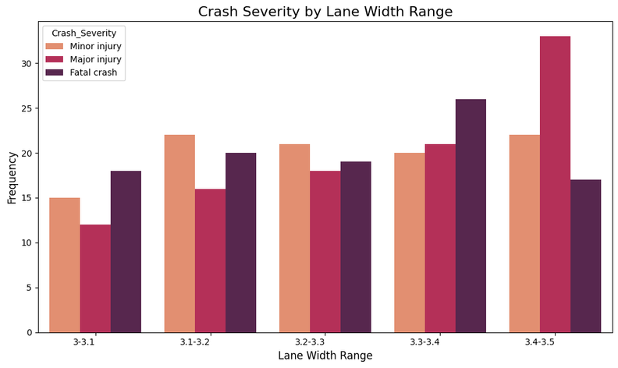
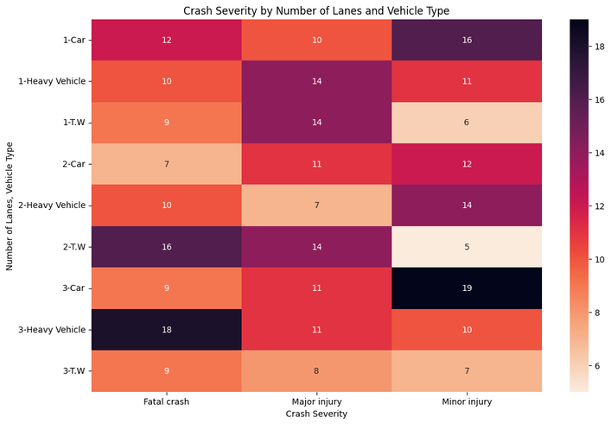
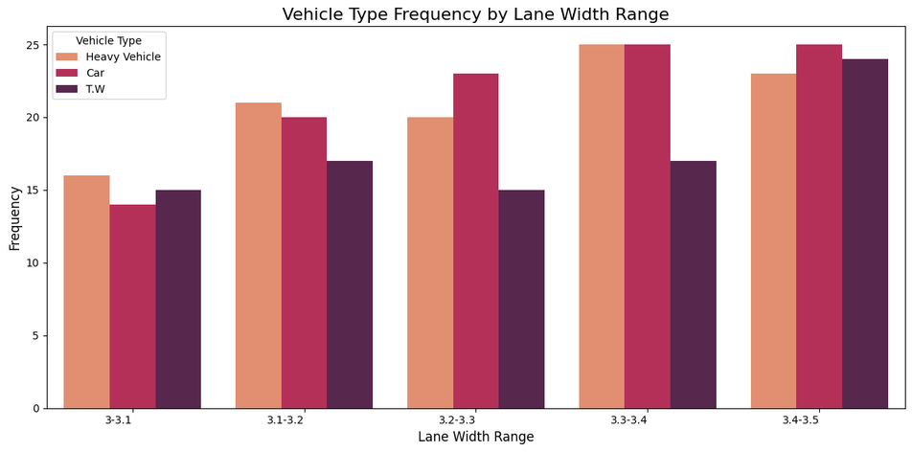
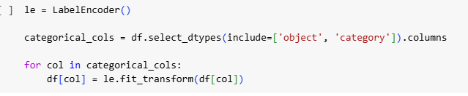
EDA & Feature Engineering
M.L.
Model
Introduction
Proposed
Solution
EDA
Conclusion
IMPORTANT GRAPHS AND INSIGHTS 2
The histogram of lane width range, in relation to crash severity, shows that the majority of crashes occur within the 3.4 to 3.5-meter range. Additionally, fatal crashes are more prevalent in the 3.3 to 3.4-meter range.
The heatmap reveals that 2-wheelers (T.W.) on two-lane roads experience the highest number of fatal crashes, whereas cars on three-lane roads are more associated with minor injuries. Heavy vehicles on three-lane roads exhibit a notable frequency of fatal crashes, highlighting their risk on wider roads.
Overall, the graph shows that lane width has a significant impact on the frequency of different vehicle types.
Heavy vehicles are most common on wider lanes (3.4-3.5 meters), while cars are more frequent on narrower lanes (3-3.1 meters).
T.W vehicles (likely trucks) are relatively consistent across lane widths, but show a slight preference for wider lanes.
The frequency of all vehicle types generally increases with lane width.
Label encoding

Slide 6
Machine Learning Models Applied
M.L.
Model
Introduction
Proposed
Solution
EDA
Conclusion
Aspect | Random Forest | XGBoost | LightGBM | CatBoost
Algorithm Type | Ensemble of Decision Trees (Bagging) | Gradient Boosting with Decision Trees | Gradient Boosting with Histogram-based Trees | Gradient Boosting with Categorical Feature Support
Overfitting | Lower risk (due to bagging) | Higher risk (needs regularization) | Moderate (needs careful parameter tuning) | Lower risk (due to built-in regularization)
Feature Importance | Provides straightforward feature importance scores | Provides importance via SHAP or gain | Provides importance via SHAP or gain | Provides importance via SHAP or loss
Hyperparameter Tuning | Requires less tuning | Requires extensive tuning for optimal performance | Requires moderate tuning | Requires moderate tuning
Dataset Size | Handles small to medium-sized datasets effectively | Handles medium to large datasets well | Handles very large datasets efficiently | Handles both small and large datasets well
Best Use Cases | Baseline model, feature importance analysis | Complex data with non-linear relationships | High-dimensional and very large datasets | Datasets with categorical features and imbalanced data

Slide 7
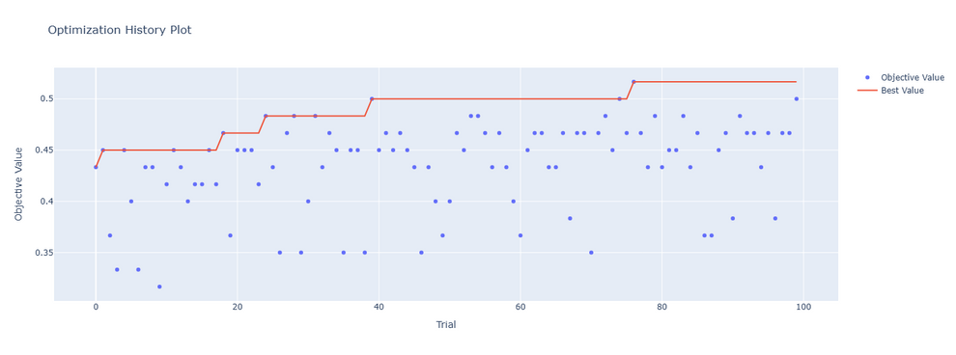
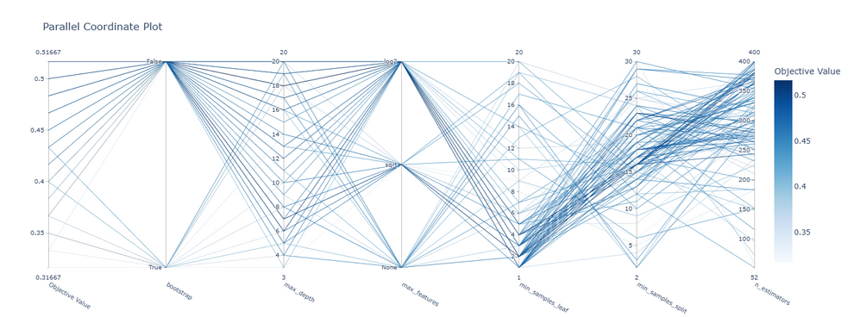
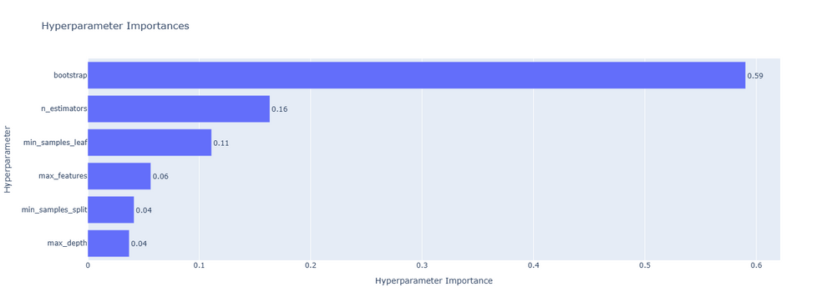
Hyperparameter Tuning
M.L.
Model
Introduction
Proposed
Solution
EDA
Conclusion
Hyperparameter Tuning
To achieve optimal performance for our models, we used Optuna, a powerful optimization framework, to tune hyperparameters.
Optuna uses Tree-Structured Parzen Estimators (TPE), a Bayesian optimization approach.
Optuna dynamically adjusts the hyperparameter search space based on observed results, helps to converge faster.
Optuna Graphs
Optimization History Plot:
This plot visualizes how the performance metric improves across trials. Each point represents a trial, showing its score.
Parallel Coordinate Plot:
It maps hyperparameter values and their relationships to performance, helping identify optimal parameter combinations or dependencies.
Hyperparameter Importance:
It highlights the most critical parameters, enabling targeted fine-tuning and reducing unnecessary optimization efforts.
Process
Conducted multiple trials for each model using Optuna.
Leveraged the insights from the graphs to refine the parameter search space.

Slide 8
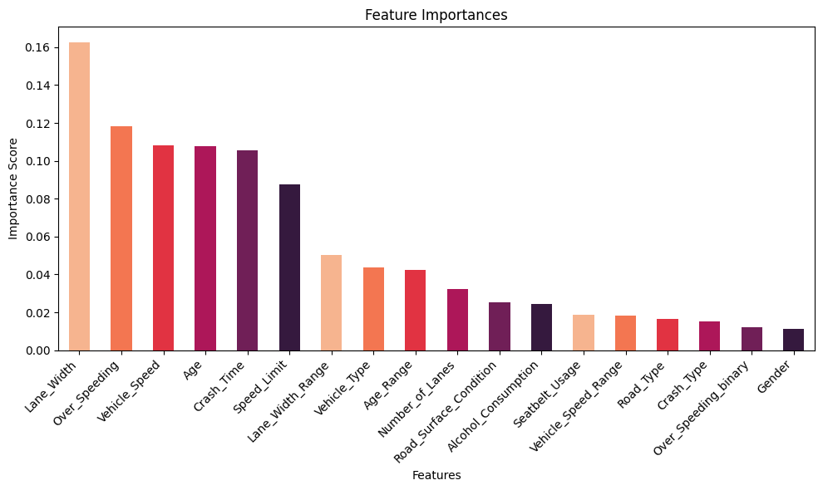
Feature Selection Strategy
M.L.
Model
Introduction
Proposed
Solution
EDA
Conclusion
To improve the model's accuracy, we utilized a feature selection strategy by focusing on the top 5 features identified through feature importance analysis. These features are highly predictive, and removing less relevant ones reduced noise and increased overall model performance.
Objective
Approach
Used feature importance scores from the Random Forest model.
Selected the top 5 features for training:
Lane_Width
Over_Speeding
Vehicle_Speed
Age
Crash_Time
Result
Improved model accuracy by leveraging only the most impactful features.
We have been able to increase the accuracy significantly by reducing the number of features. (approx 5%)

Slide 9
Model Performance & Impact
M.L.
Model
Introduction
Proposed
Solution
EDA
Conclusion
Performance
Random Forest: Good performance and simpler model; no need for complex models like XGBoost, LightGBM, or CatBoost in this case.
Low Accuracy: Accuracy is lower due to the small dataset size.
Comparison: Random Forest and CatBoost outperformed XGBoost and LightGBM, as XGBoost and LightGBM are not designed to handle small datasets effectively.
Model | Accuracy
Random Forest | 0.5667
XGBOOST | 0.48
LightGBM | 0.45
CatBoost | 0.55
Impact
Feature Importance: Feature importance from Random Forest was used to identify key features.
Proposed Solution: Based on feature importance, solutions were proposed to improve road safety.

Slide 10
Proposed
Solution
M.L.
Model
Introduction
Proposed
Solution
EDA
Conclusion
Dynamic Speed Limits
Introduce speed limits that adjust based on traffic conditions, weather, and time of day.
Use electronic display boards to communicate real-time speed limits.
Advanced Traffic Monitoring
Install surveillance cameras and sensors to monitor and enforce compliance with speed limits and lane usage.
Use AI-based systems for real-time traffic analysis and quick incident detection.
Dedicated Lanes
Create separate lanes for heavy vehicles, two-wheelers, and pedestrians to minimize interaction and reduce collision risks.
Ensure proper signage and physical lane segregation wherever possible.
Urban Planning for Traffic Flow
Encourage alternative commuting methods such as carpooling and public transport to reduce vehicular congestion.
Plan new roads and flyovers to manage high-traffic areas efficiently.

Slide 11
M.L.
Model
Introduction
Proposed
Solution
Conclusion
EDA
Conclusion
Road accidents pose a significant challenge to public safety, with outcomes ranging from minor injuries to fatalities.
Predictive modeling using machine learning offers a powerful tool to analyze accident data and identify key risk factors.
The model demonstrated its potential but was limited by the lack of a larger and more diverse dataset, which could enhance its accuracy and generalizability.
By understanding these insights, we can develop effective strategies to reduce crash severity and enhance road safety.
Summary:
Model Insights:
Identified critical factors influencing accident severity, such as speed, road conditions, and seatbelt usage.
Demonstrated how predictive analytics can classify accident severity effectively.
Practical Recommendations:
Implement road design improvements, better traffic management, and enforcement of safety regulations.
Enhance public awareness about critical risk factors like seatbelt usage and alcohol consumption while driving.
Key Takeaways:
Expanding the dataset with additional features (e.g. advanced vehicle telemetry data, driver fatigue indicators).
Deploying predictive tools in real-world scenarios for emergency response and policy formulation.
Collaborating with stakeholders to foster safer transportation systems worldwide.
Future Scope:
“Together, we can save lives and build safer roads for everyone.”

